Slide 1




NEXT GEN EMPLOYABILITY PROGRAM
Creating a future-ready workforce
Team Members
College Name
Student Name :Sowmiya.R.M.
Student ID :au960221243047
Arunachala College of Engineering for Women

Slide 2

CAPSTONE PROJECT SHOWCASE
Project Title
Car Rentals Application with Django Framework
Abstract | Problem Statement | Project Overview | Proposed Solution | Technology Used | Modelling & Results | Conclusion

Slide 3
Abstract
This project introduces an agile car rental web application developed using the Django framework, designed to revolutionize the traditional car rental experience. Customers can easily create accounts, search for cars based on their preferences, book rentals, and track their reservations with a user-friendly interface. By leveraging Django's powerful features, this application enhances the efficiency and convenience of car rental operations, offering a seamless experience for both users and administrators.
Source :

Slide 4
Problem Statement
The traditional process of renting cars is often plagued by inefficiencies, inconvenience, and lack of transparency for both customers and rental companies. Manual paperwork, limited vehicle availability, and complex reservation systems contribute to a suboptimal experience for users and hinder the growth potential of rental businesses. Moreover, managing a fleet of vehicles and tracking reservations manually can lead to errors, delays, and missed opportunities for revenue optimization.
Source :

Slide 5
Project Overview
The Car Rentals Web Application is a comprehensive platform designed to streamline the process of renting vehicles for both customers and rental companies.
Key Features:
User Authentication: Users can create accounts, log in, and manage their profiles.
Vehicle Listings: Customers can browse a diverse range of vehicles available for rent.
Reservation Management: The system provides real-time availability updates and confirmation notifications.
Booking Management: Users can modify or cancel reservations as needed.
Reporting and Analytics: The system generates comprehensive reports and analytics for rental companies, providing insights into rental trends, revenue generation, and customer preferences.
Source :

Slide 6
Proposed Solution
The proposed solution entails the development of a sophisticated yet user-friendly car rental management system using the Django framework. This system aims to streamline the entire rental process for both customers and rental companies, offering an intuitive interface, robust features, and scalability.
User Authentication and Profiles:
Users can register, log in securely, and manage their profiles.
Rental company administrators have access to a separate dashboard for managing their rental operations.
Vehicle Listings and Search:
Customers can browse through a diverse range of vehicles with detailed specifications.
Source :

Slide 7
Reservation Management:
Users can make reservations for specific vehicles, selecting rental dates, pickup/drop-off locations, and additional services if needed.
Real-time availability checking ensures accurate reservation scheduling.
Fleet Management:
Rental company administrators can manage their vehicle fleet efficiently, including adding new vehicles, updating availability, and setting rental rates.
Detailed inventory tracking helps monitor vehicle status, maintenance schedules, and rental history.

Slide 8
Technology Stack:
Django Framework: Provides a robust and scalable foundation for building the web application.
Python: Backend development for implementing business logic, data processing, and interaction with the database.
HTML/CSS/JavaScript: Frontend development for creating responsive and interactive user interfaces.
Bootstrap: Frontend framework for styling and layout design to ensure consistency and usability across devices.

Slide 9


Technology Used
Front-end
Back-end
Source :

Slide 10
Modelling & Results
The program would involve training employees in utilizing these technologies effectively, developing problem-solving skills, and fostering a customer-centric mindset. Results could include improved operational efficiency, reduced downtime, enhanced customer satisfaction, and a skilled workforce ready to adapt to future industry trends. A Next Gen Employability program for car rentals could focus on incorporating cutting-edge technology such as AI-driven vehicle tracking systems, predictive maintenance algorithms, and customer experience enhancements.
Source :

Slide 11
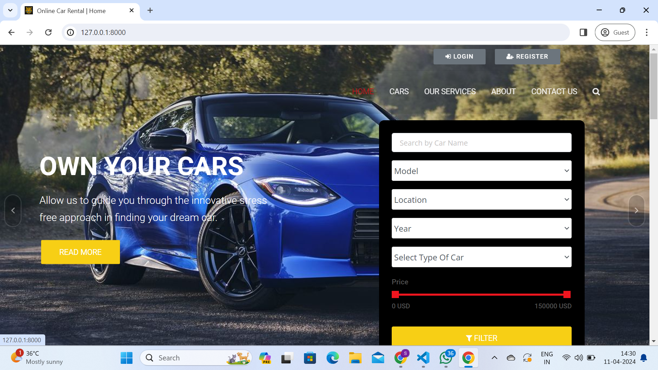
Homepage

Slide 12
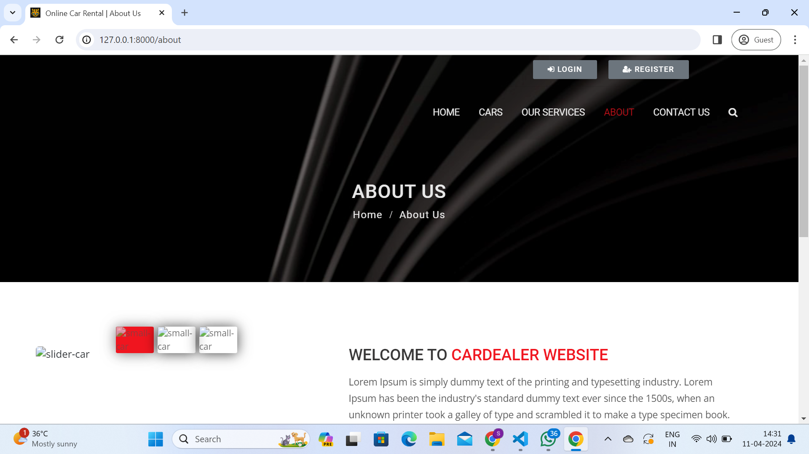
About-Us-Page

Slide 13
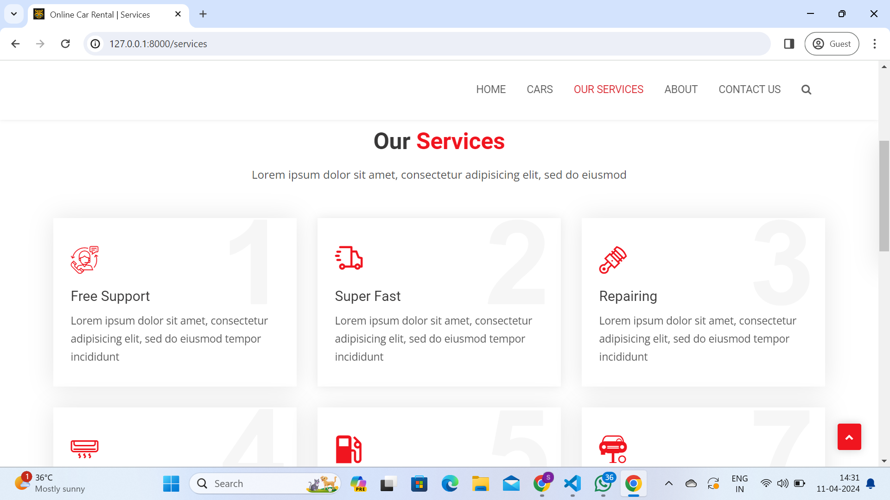
Service-Page

Slide 14
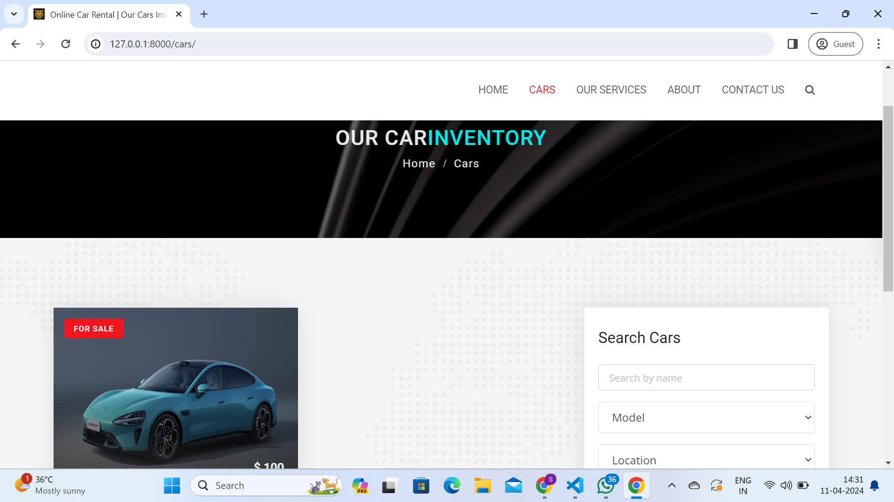
Departments-Page

Slide 15
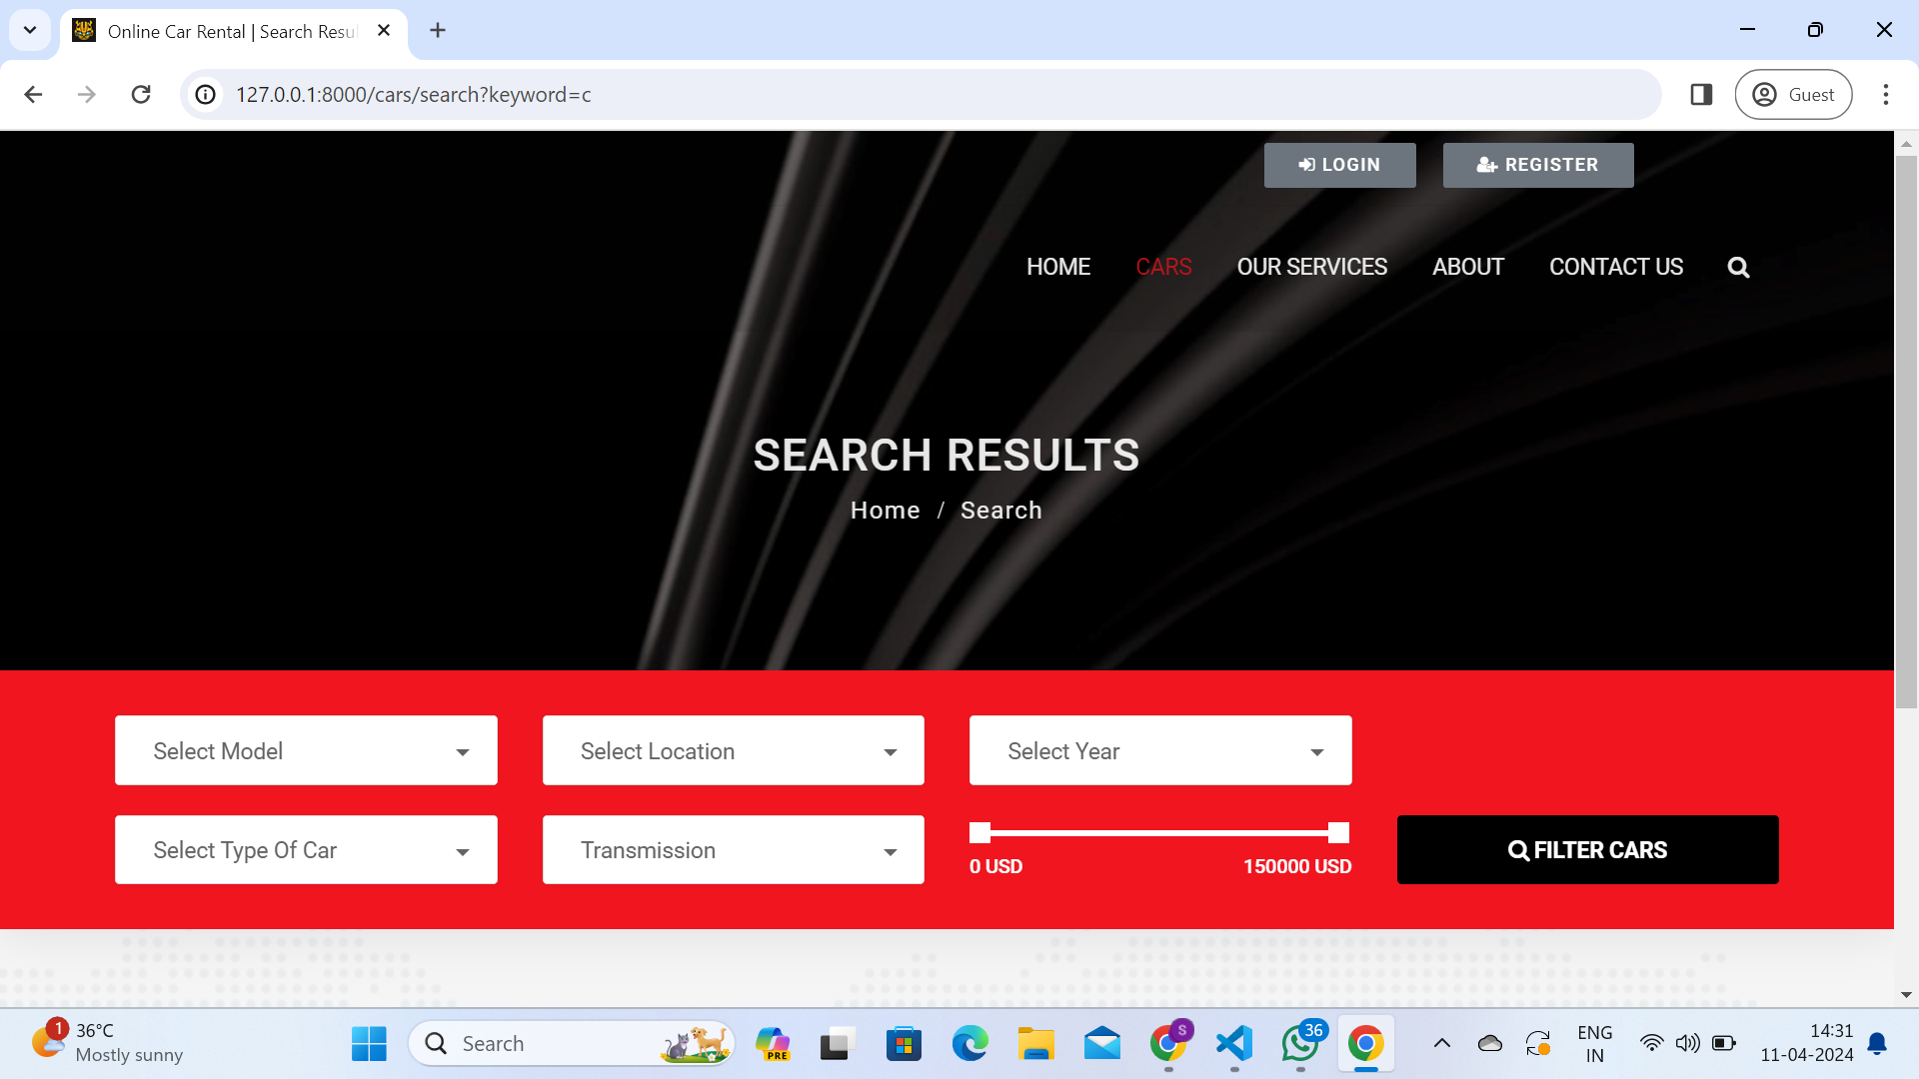
Blog-Page

Slide 16
Future Enhancements:
Integration with third-party APIs for additional features such as location-based services, vehicle tracking, and insurance verification.
Implementing advanced search and filtering options for vehicle listings to enhance the user experience.
Incorporating machine learning algorithms for predictive analytics, dynamic pricing, and personalized recommendations.
Expanding the application to support multi-language and multi-currency options for a global user base.

Slide 17
Conclusion
The Car Rentals Web Application with Django Framework aims to revolutionize the car rental industry by offering a seamless, transparent, and efficient rental experience for both customers and rental companies.
With its user-friendly interface, robust features, and scalability, the application sets a new standard for car rental management systems, catering to the evolving needs of the market.
Source :

Slide 18
Thank You!
Notes:
Thank You !!

